Slide 1

Stage 1/Bay 1 Not A Track Meet Course Designer: Eric Beerbaum
Not A Track Meet is a 30 round, 150 point Comstock Long course. There are 12 USPSA targets and 6 steel targets. The best 2 hits per target will score. The start signal is audible.
The start position is standing with feet touching start stick. Handgun loaded and holstered, wrists below belt. PCC loaded, safety on, stock touching belt.
On the audible start signal, engage all targets from within the shooting areas.

Slide 2
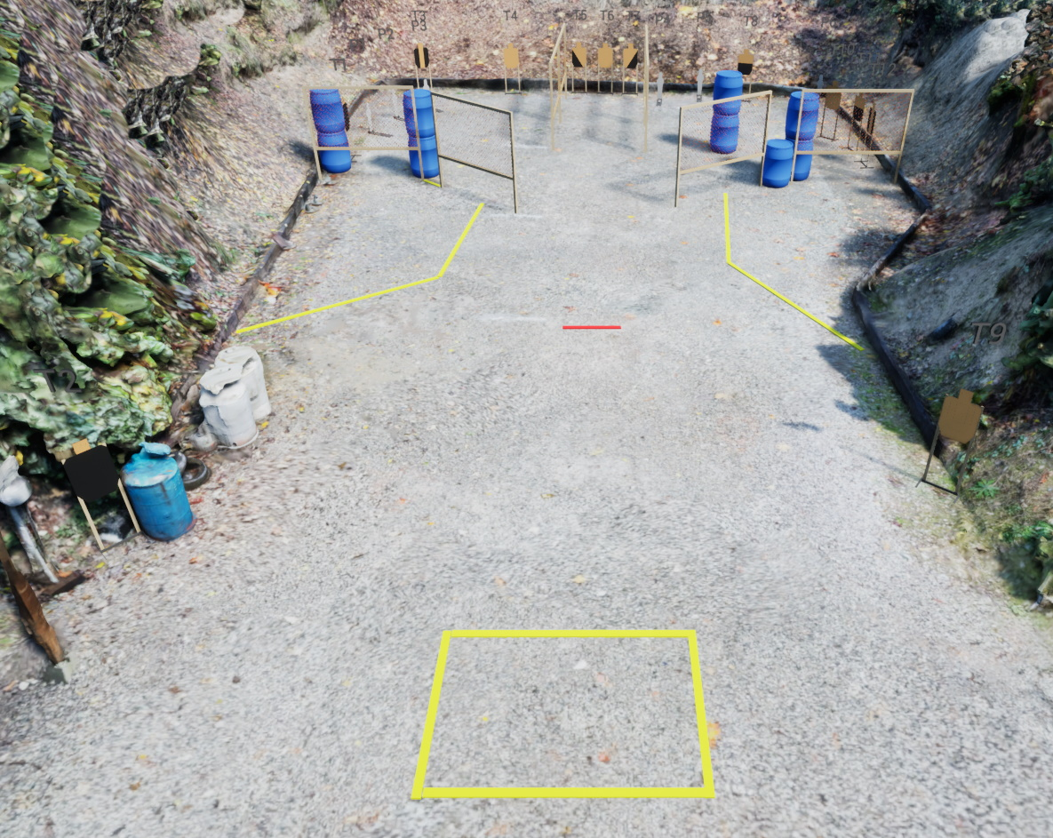
 | Stage 1/Bay 1 Not A Track Meet Course Designer: Eric Beerbaum

